Slide 1
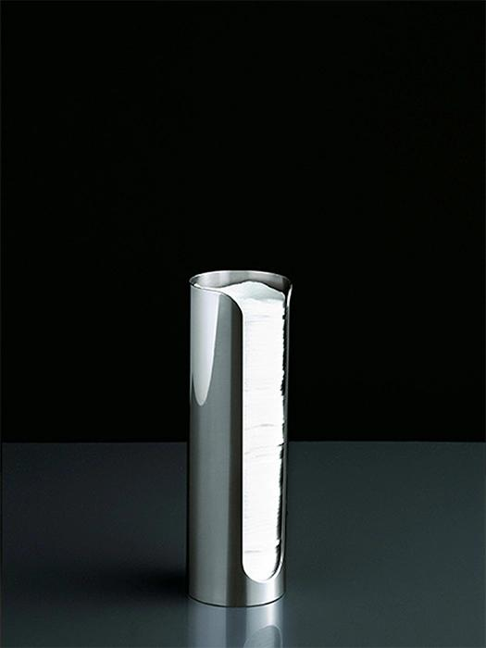
Product
© 2025 Altossa Projects LLP. All Rights Reserved.
www.boffi.com/en/collection/italian-luxury-bathrooms/bathroom-accessories/blade

Slide 2
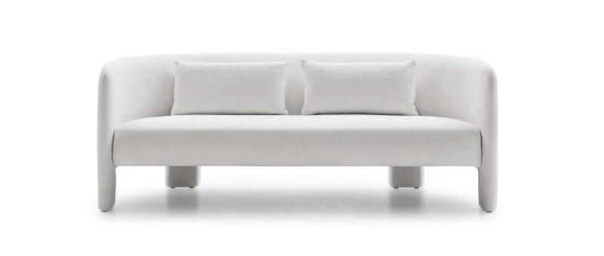
Sofa
© 2025 Altossa Projects LLP. All Rights Reserved.
www.ditreitalia.com/en/products/sofas/cali-2

